Slide 1





STARTING devops with travis ci
A PRESENTATION
ON
Harish Reddy Vavilala
Introduction to DevOps
Aarjap Piya
DevOps tools and phases
Manasa Ginjupalli
Introduction on Travis CI
Roshan Thalal – Hands on demo
Meghana Putta – Hands on demo

Slide 2

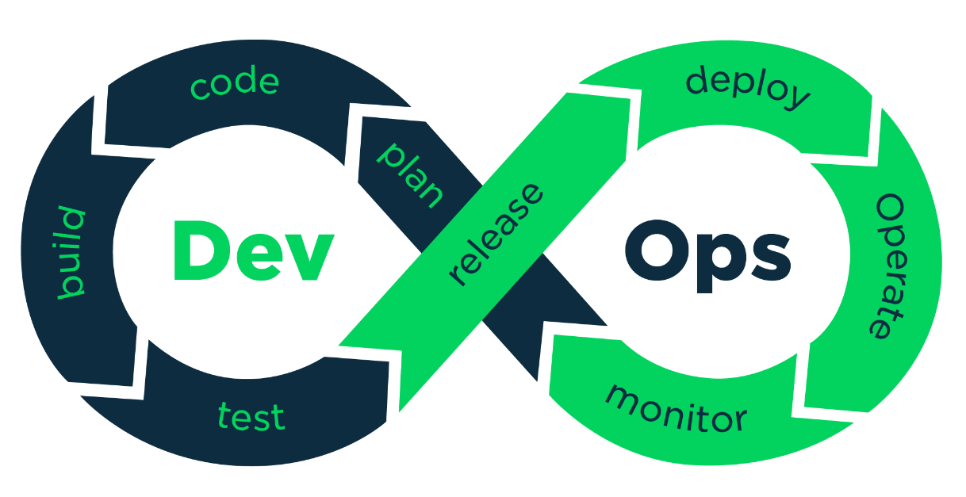
STARTING devops with travis ci

Slide 3
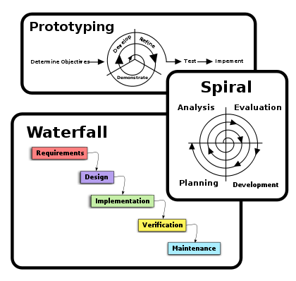
Evolution of Software development process
The last twenty years has seen major changes in the technologies we use to build software, but most significantly, the way we build software has fundamentally evolved to improve the quality, accuracy, and speed of delivered software
Traditionally, once the development team completed their work, it was passed to an operational team for deployment and production support
PRESENTER – HARISH REDDY VAVILALA

Slide 4
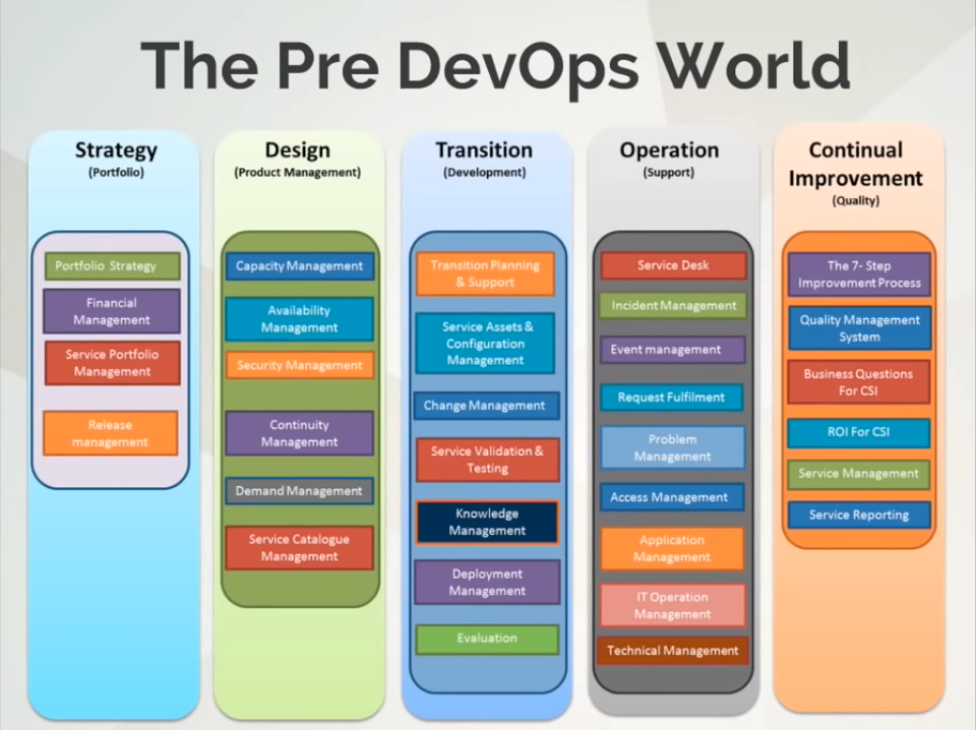
PRESENTER – HARISH REDDY VAVILALA

Slide 5
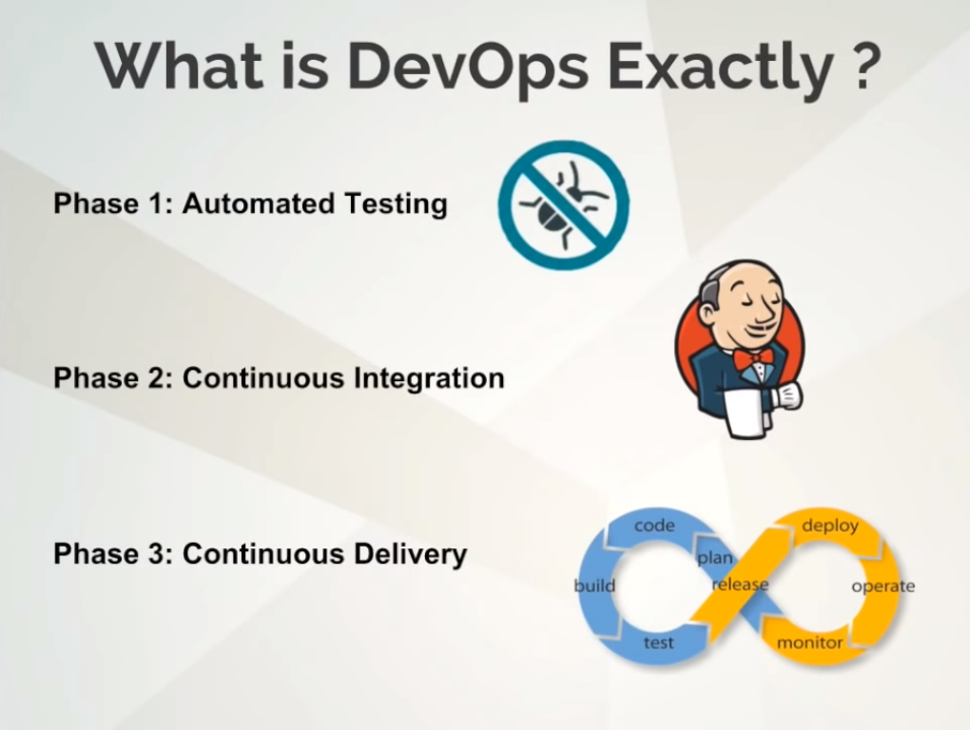
PRESENTER – HARISH REDDY VAVILALA

Slide 6
WHY DOES IT MATTER?
FASTER TIME TO MARKET
HIGHER QUALITY / FEWER BUGS
LOWER COST TO DELIVER
PRESENTER – HARISH REDDY VAVILALA

Slide 7
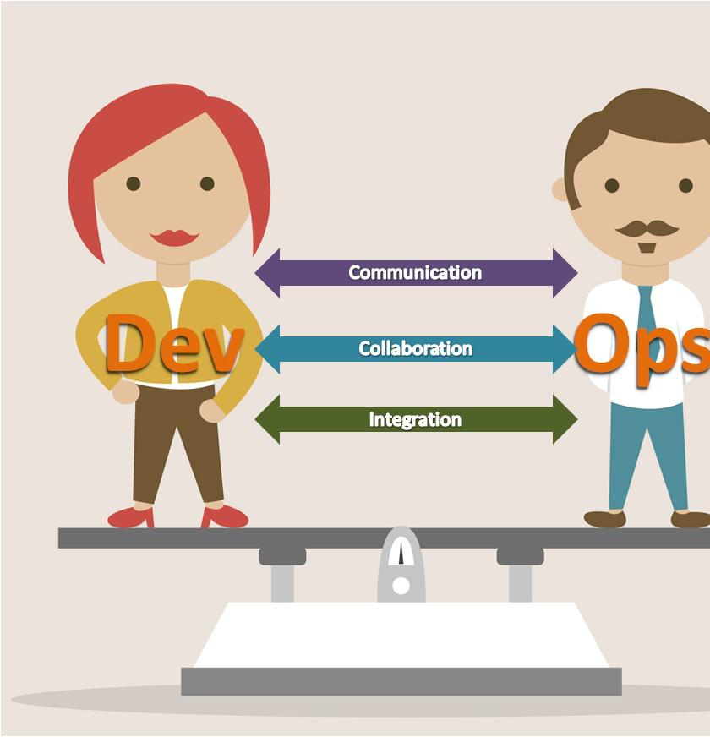
Recap DevOps
a software development strategy.
it is not a tool, technology or a app.
It is a strategy which bridges the gap between the development and the operation team.
Dev wants agility whereas Ops team want stability.
So DevOps bring two side of the team together.
PRESENTER – AARJAP PIYA

Slide 8
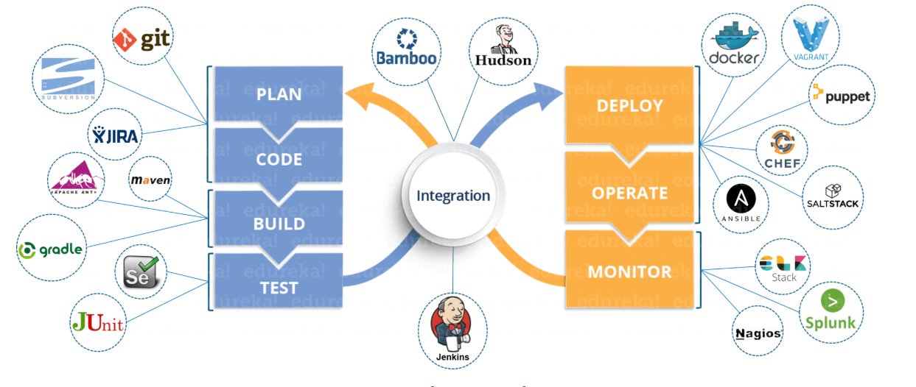
DevOps Phase And Tools
PLAN – planning your application
CODE – writing your code, but you multiple developers writing code for the application, so you need a system for that. Say if you wanted to go back to a previous commit or code. One of the preferred tools for that is Git
BUILD – this phase includes
Validation of your application
Compiling your application
Packaging your application
Performing unit test integration
IV. TEST – Build application is deployed on to the test servers for testing and once testing is done deployed onto the prod servers for release which is monitored by applications like NAGIOS, SPLUNK, STACK and so on.
PRESENTER – AARJAP PIYA

Slide 9
DevOps Phase and Tools
To DEPLOY the applications onto the prod servers we use tool like puppet, chef, ansible and so on.
INTEGRATION is the heart of DevOps
One of the famous integration tool is Jenkins and Travis CI
Integrates all the stages we have seen so far like coding, building, deploying and so on
Anytime changes are made into the source code of the shared repository, Travis CI will pull that code and prepare a build and once it is complete it will deploy it to the test servers for testing and finally to the prod servers which is then monitored.
PRESENTER – AARJAP PIYA

Slide 10

How do you implement DevOps in Real Life
Say you have a source code in the git repository which is managed by multiple developers
Travis CI will pull that code prepare a build then deploy it onto the test servers and then finally deploy it onto the test servers which is then monitored
PRESENTER – AARJAP PIYA

Slide 11
So why do we need DevOps?
They maintain the historical record of your system and also ensures you have the same computing environment.
A example of PUPPET a open-source configuration management tool where it saved millions of dollars.
In New York stock exchange a software was upgraded with the help of Puppet, it was working fine that day but the next day it had a lot of bugs. With help of puppet they were able to go back to the stable version of the software.
PRESENTER – AARJAP PIYA

Slide 12
TRAVIS CI
Why and Where it is used?
Advantages and Examples
Presenter : Manasa Ginjupalli

Slide 13
TRAVIS CI
Travis CI is a hosted and continuous integration service that is used to build and test software projects.
It is configured by adding .travis.yml, which is YAML format text file to the root directory of repository.
Travis CI supports on wide range of machines and also working with numerous programming languages such as c, c ++, c#, java, java script, python, apache groovy etc…..
Travis CI also provides user different infrastructure environments such as container-based, sudo-enabled and OS X.
Presenter : Manasa Ginjupalli

Slide 14
TRAVIS CI
Travis CI also notifies the user automatically when commit is done and pushed into Github repository.
Following are some important reasons to use Travis CI :
Easy use and setup
Always there
Ensures safety
Better tests
Alerts
Travis CI can also be used with Bitbucket and its also one of the effective ways to test your code.
https://docs.travis-ci.com/user/deployment/atlas/
Presenter : Manasa Ginjupalli

Slide 15
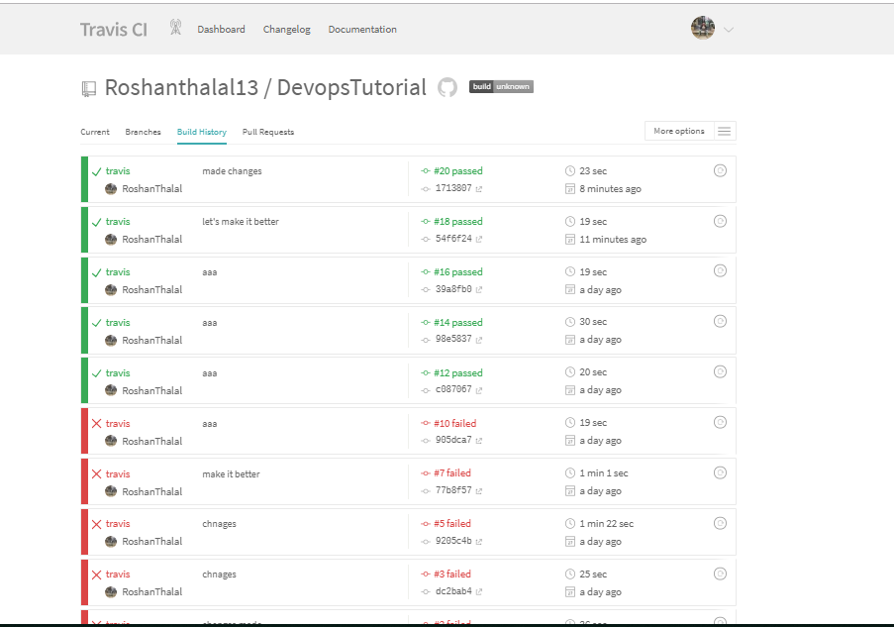
PRESENTERS: MEGHANA PUTTA & ROSHAN THALAL

Slide 16
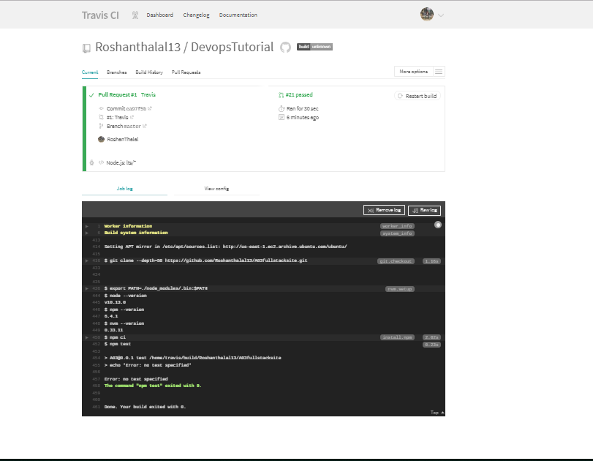
PRESENTERS: MEGHANA PUTTA & ROSHAN THALAL

Slide 17
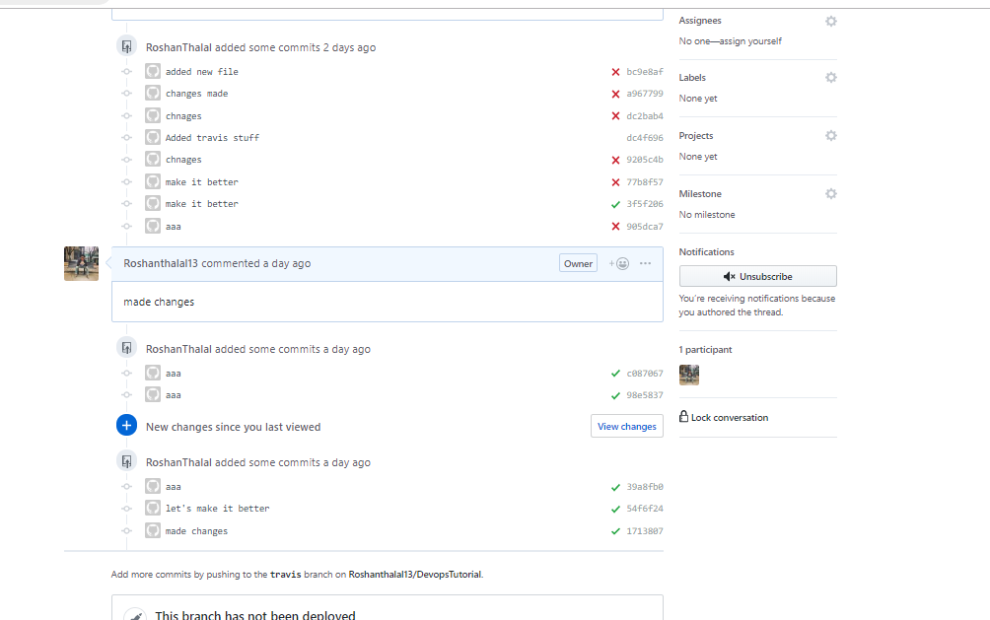
PRESENTERS: MEGHANA PUTTA & ROSHAN THALAL

Slide 18
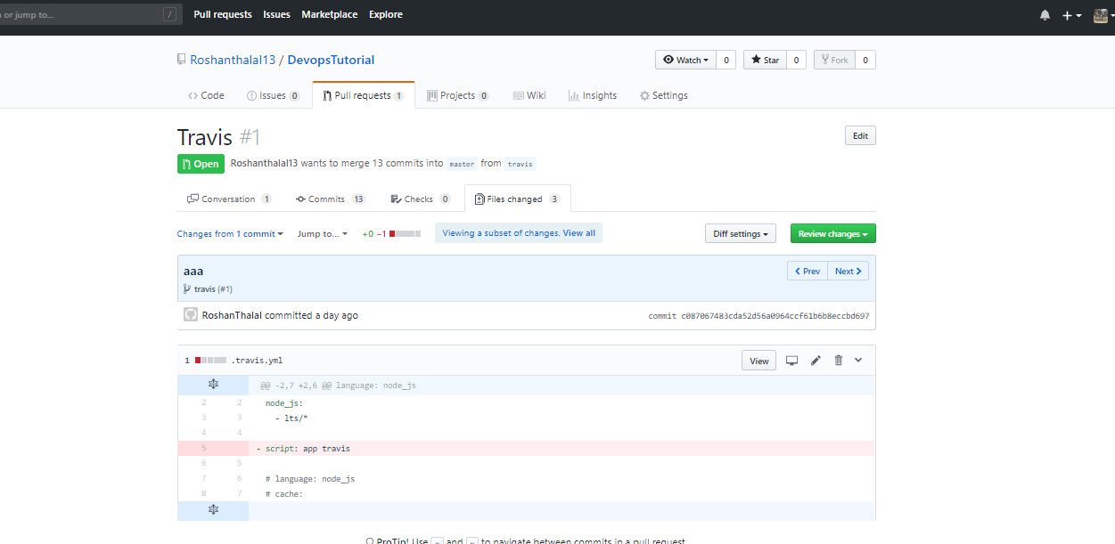
PRESENTERS: MEGHANA PUTTA & ROSHAN THALAL

Slide 19
References:
http://garyclarke.us/technology/the-evolution-of-software-development-practices/
https://www.youtube.com/watch?v=3EyT1i0wYUY&list=PL9ooVrP1hQOE5ZDJJsnEXZ2upwK7aTYiX
https://docs.travis-ci.com/user/tutorial/?fbclid=IwAR2hL2SS4kLPmmf-7jnnCoJZrQLz6ppbtsEBlEq1uAMpr9FAM4EEqeTtAU4
https://www.youtube.com/watch?v=Uft5KBimzyk
https://docs.travis-ci.com/user/deployment/atlas/
All Pictures are from google.

Slide 20

anY Queries?

Slide 21
Thank you!

